Slide 1
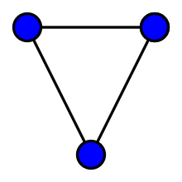
Chapter 10 Graphs
Definition: A graph G = (V, E) consists of a nonempty set V of vertices (or nodes) and a set E of edges. Each edge has either one or two vertices associated with it, called its endpoints. An edge is said to connect its endpoints.
Basic Types of GRAPH
Simple Graph
Multi Graph
Pseudo Graph
Null Graph
Complete Graph
Regular Graph

Slide 2
Some Terminology
In a simple graph each edge connects two different vertices and no two edges connect the same pair of vertices.
Multigraphs may have multiple edges connecting the same two vertices. When m different edges connect the vertices u and v, we say that {u,v} is an edge of multiplicity m.
An edge that connects a vertex to itself is called a loop.
A pseudograph may include loops, as well as multiple edges connecting the same pair of vertices.
Example:
This pseudograph has both multiple edges and a loop.
a
b
Remark: There is no standard terminology for graph theory. So, it is crucial that you understand the terminology being used whenever you read material about graphs.
c

Slide 3
Directed Graphs
Definition: A directed graph (or digraph) G = (V, E) consists of a nonempty set V of vertices (or nodes) and a set E of directed edges (or arcs). Each edge is associated with an ordered pair of vertices. The directed edge associated with the ordered pair (u,v) is said to start at u and end at v.
Remark:
Graphs where the end points of an edge are not ordered are said to be undirected graphs.

Slide 4
Some Terminology (continued)
A simple directed graph has no loops and no multiple edges.
A directed multigraph may have multiple directed edges. When there are m directed edges from the vertex u to the vertex v, we say that (u,v) is an edge of multiplicity m.
a
b
Example:
This is a directed graph with three vertices and four edges.
c
Example:
In this directed multigraph the multiplicity of (a,b) is 1 and the multiplicity of (b,c) is 2.
a
b
c

Slide 5
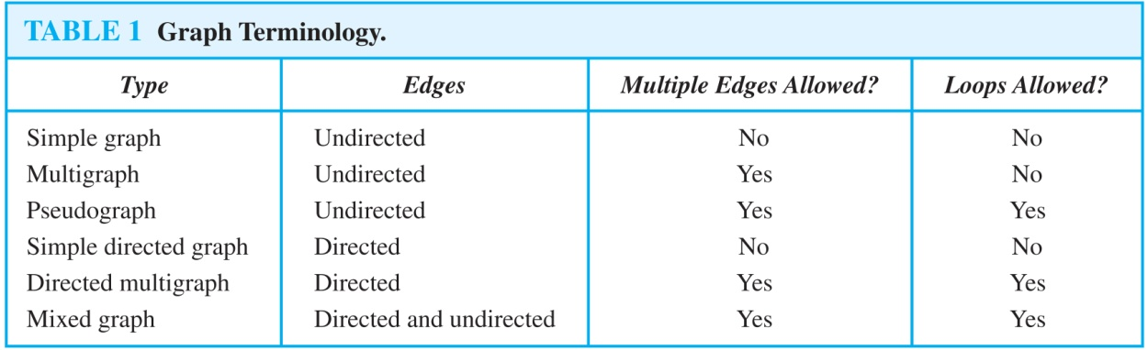
Graph Terminology: Summary
To understand the structure of a graph and to build a graph model, we ask these questions:
Are the edges of the graph undirected or directed (or both)?
If the edges are undirected, are multiple edges present that connect the same pair of vertices? If the edges are directed, are multiple directed edges present?
Are loops present?

Slide 6
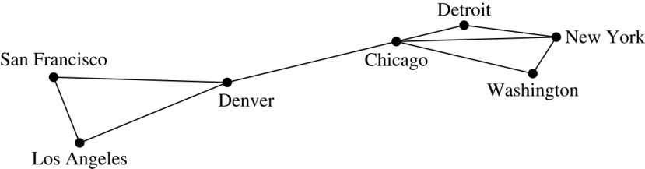
10.1 Graphs and Graph Models
When we build a graph model, we use the appropriate type of graph to capture the important features of the application.
We illustrate this process using graph models of different types of computer networks. In all these graph models, the vertices represent data centers and the edges represent communication links.
To model a computer network where we are only concerned whether two data centers are connected by a communications link, we use a simple graph. This is the appropriate type of graph when we only care whether two data centers are directly linked (and not how many links there may be) and all communications links work in both directions.

Slide 7
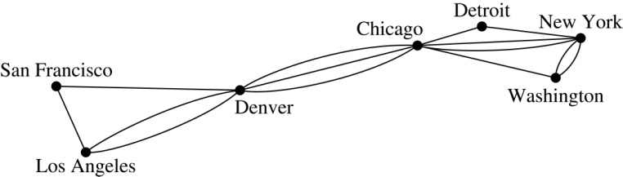
Graph Models: Computer Networks (continued)
To model a computer network where we care about the number of links between data centers, we use a multigraph.

Slide 8
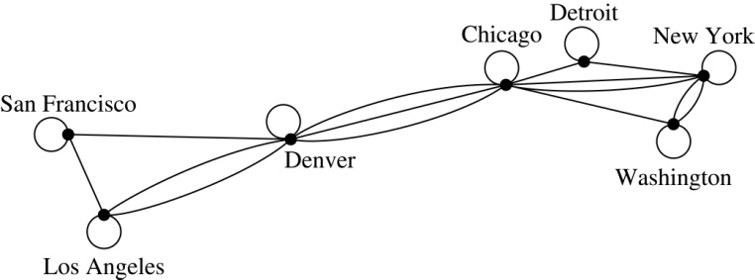
Graph Models: Computer Networks
To model a computer network with diagnostic links at data centers, we use a pseudograph, as loops are needed.

Slide 9
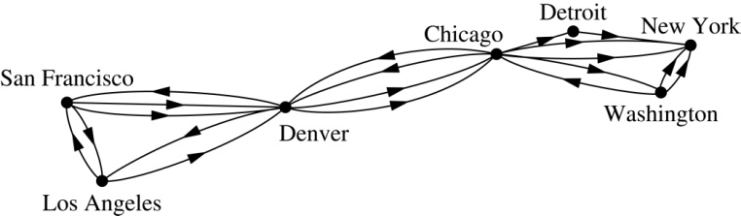
Graph Models: Computer Networks
To model a network with multiple one-way links, we use a directed multigraph. Note that we could use a directed graph without multiple edges if we only care whether there is at least one link from a data center to another data center.

Slide 10
Graph Models: Social Networks
Graphs can be used to model social structures based on different kinds of relationships between people or groups.
In a social network, vertices represent individuals or organizations and edges represent relationships between them.
Useful graph models of social networks include:
friendship graphs - undirected graphs where two people are connected if they are friends (in the real world, on Facebook, or in a particular virtual world, and so on.)
collaboration graphs - undirected graphs where two people are connected if they collaborate in a specific way
influence graphs - directed graphs where there is an edge from one person to another if the first person can influence the second person..

Slide 11
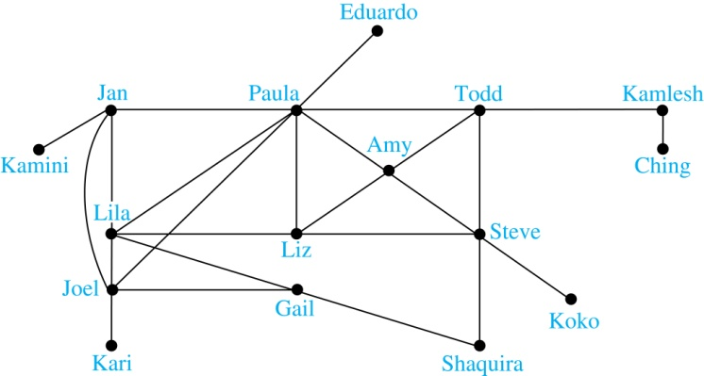
Graph Models: Social Networks
Example: A friendship graph where two people are connected if they are Facebook friends.

Slide 12
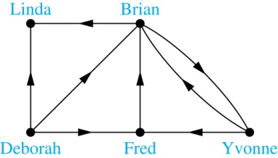
Graph Models: Social Networks
Example: An influence graph

Slide 13
Applications to Information Networks
Graphs can be used to model different types of networks that link different types of information.
In a web graph, web pages are represented by vertices and links are represented by directed edges.
A web graph models the web at a particular time.
We will explain how the web graph is used by search engines in Section 11.4.
In a citation network:
Research papers in a particular discipline are represented by vertices.
When a paper cites a second paper as a reference, there is an edge from the vertex representing this paper to the vertex representing the second paper.

Slide 14
Transportation Graphs
Graph models are extensively used in the study of transportation networks.
Airline networks can be modeled using directed multigraphs where
airports are represented by vertices
each flight is represented by a directed edge from the vertex representing the departure airport to the vertex representing the destination airport
Road networks can be modeled using graphs where
vertices represent intersections and edges represent roads.
undirected edges represent two-way roads and directed edges represent one-way roads.

Slide 15
Software Design Applications
Graph models are extensively used in software design. We will introduce two such models here; one representing the dependency between the modules of a software application and the other representing restrictions in the execution of statements in computer programs.
When a top-down approach is used to design software, the system is divided into modules, each performing a specific task.
We use a module dependency graph to represent the dependency between these modules. These dependencies need to be understood before coding can be done.

Slide 16
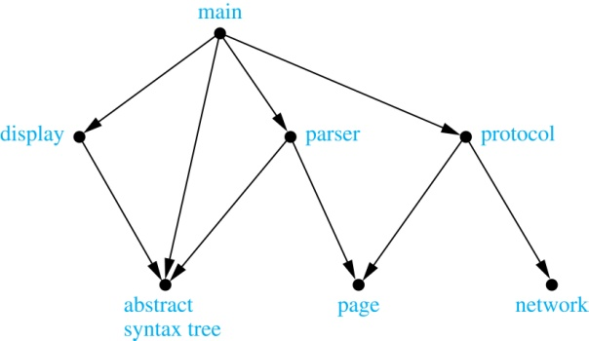
Software Design Applications
In a module dependency graph vertices represent software modules and there is an edge from one module to another if the second module depends on the first.
Example: The dependencies between the seven modules in the design of a web browser are represented by this module dependency graph.

Slide 17
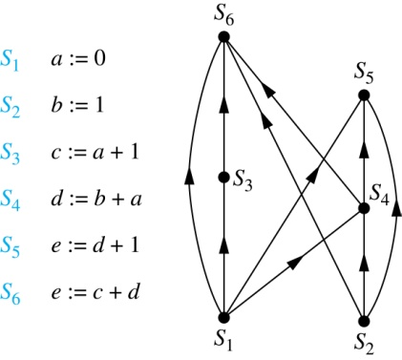
Software Design Applications
We can use a directed graph called a precedence graph to represent which statements must have already been executed before we execute each statement.
Vertices represent statements in a computer program
There is a directed edge from a vertex to a second vertex if the second vertex cannot be executed before the first
Example: This precedence graph shows which statements must already have been executed before we can execute each of the six statements in the program.

Slide 18
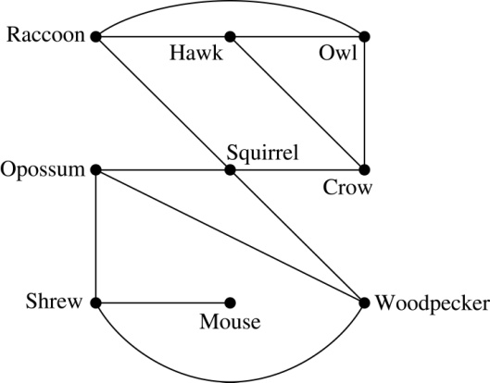
Biological Applications
Graph models are used extensively in many areas of the biological science. We will describe two such models, one to ecology and the other to molecular biology.
Niche overlap graphs model competition between species in an ecosystem
Vertices represent species and an edge connects two vertices when they represent species who compete for food resources.
Example: This is the niche overlap graph for a forest ecosystem with nine species.

Slide 19
Biological Applications
We can model the interaction of proteins in a cell using a protein interaction network.
In a protein interaction graph, vertices represent proteins and vertices are connected by an edge if the proteins they represent interact.
Protein interaction graphs can be huge and can contain more than 100,000 vertices, each representing a different protein, and more than 1,000,000 edges, each representing an interaction between proteins
Protein interaction graphs are often split into smaller graphs, called modules, which represent the interactions between proteins involved in a particular function.

Slide 20
Graph Terminology and Special Types of Graphs
Section 10.2
FREE: For Complete Playlist: https://www.youtube.com/c/FahadHussaintutorial/playlists
For Code, Slide and Books: https://fahadhussaincs.blogspot.com/

Slide 21
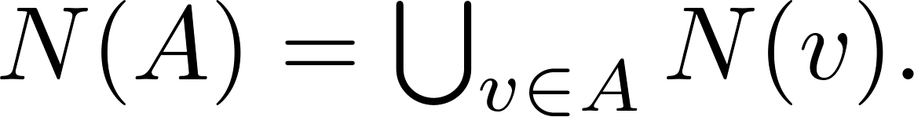
Basic Terminology
Definition 1. Two vertices u, v in an undirected graph G are called adjacent (or neighbors) in G if there is an edge e between u and v. Such an edge e is called incident with the vertices u and v and e is said to connect u and v.
Definition 2. The set of all neighbors of a vertex v of G = (V, E), denoted by N(v), is called the neighborhood of v. If A is a subset of V, we denote by N(A) the set of all vertices in G that are adjacent to at least one vertex in A. So,
Definition 3. The degree of a vertex in a undirected graph is the number of edges incident with it, except that a loop at a vertex contributes two to the degree of that vertex. The degree of the vertex v is denoted by deg(v).
FREE: For Complete Playlist: https://www.youtube.com/c/FahadHussaintutorial/playlists
For Code, Slide and Books: https://fahadhussaincs.blogspot.com/

Slide 22
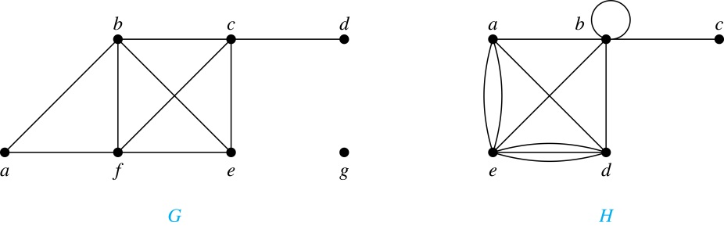
Degrees and Neighborhoods of Vertices
Example: What are the degrees and neighborhoods of the vertices in the graphs G and H?
Solution:
G: deg(a) = 2, deg(b) = deg(c) = deg(f ) = 4, deg(d ) = 1, deg(e) = 3, deg(g) = 0.
N(a) = {b, f }, N(b) = {a, c, e, f }, N(c) = {b, d, e, f }, N(d) = {c},
N(e) = {b, c , f }, N(f) = {a, b, c, e}, N(g) = ∅ .
H: deg(a) = 4, deg(b) = deg(e) = 6, deg(c) = 1, deg(d) = 5.
N(a) = {b, d, e}, N(b) = {a, b, c, d, e}, N(c) = {b}, N(d) = {a, b, e},
N(e) = {a, b ,d}.

Slide 23
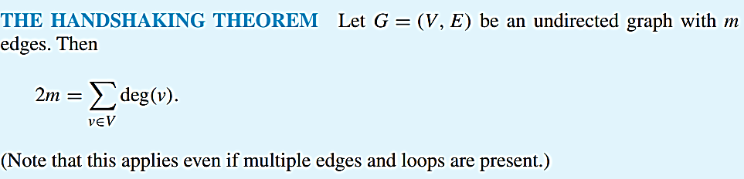
Handshaking Theorem
Theorem: If G is any graph, then the sum of the degrees of all the vertices of G equals twice the number of edges of G.
COROLLARY: The total degree of G is an even number
FREE: For Complete Playlist: https://www.youtube.com/c/FahadHussaintutorial/playlists
For Code, Slide and Books: https://fahadhussaincs.blogspot.com/

Slide 24
Handshaking Theorem
Example: How many edges are there in a graph with 10 vertices of degree six?
Solution: Because the sum of the degrees of the vertices is 6 ⋅ 10 = 60, the handshaking theorem tells us that 2m = 60. So the number of edges m = 30.
Example: If a graph has 5 vertices, can each vertex have degree 3?
Solution: This is not possible by the handshaking theorem, because the sum of the degrees of the vertices 3 ⋅ 5 = 15 is odd.
FREE: For Complete Playlist: https://www.youtube.com/c/FahadHussaintutorial/playlists
For Code, Slide and Books: https://fahadhussaincs.blogspot.com/

Slide 25
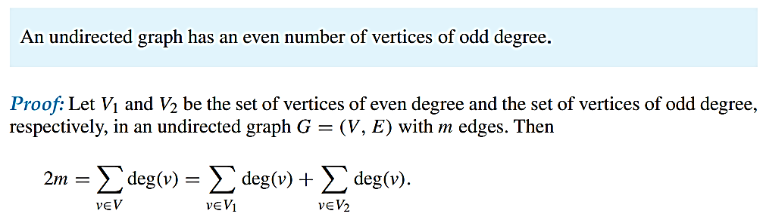
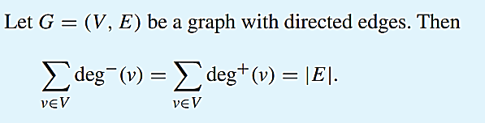
Theorms of Graph
FREE: For Complete Playlist: https://www.youtube.com/c/FahadHussaintutorial/playlists
For Code, Slide and Books: https://fahadhussaincs.blogspot.com/

Slide 26
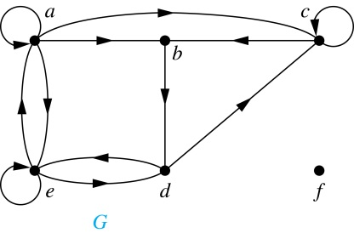
Directed Graphs (continued)
Definition: The in-degree of a vertex v, denoted deg⁻(v), is the number of edges which terminate at v. The out-degree of v, denoted deg⁺(v), is the number of edges with v as their initial vertex. Note that a loop at a vertex contributes 1 to both the in-degree and the out-degree of the vertex.
Example: In the graph G we have
deg⁻(a) = 2, deg⁻(b) = 2, deg⁻(c) = 3, deg⁻(d) = 2, deg⁻(e) = 3, deg⁻(f) = 0.
deg⁺(a) = 4, deg⁺(b) = 1, deg⁺(c) = 2, deg⁺(d) = 2, deg⁺ (e) = 3, deg⁺(f) = 0.
FREE: For Complete Playlist: https://www.youtube.com/c/FahadHussaintutorial/playlists
For Code, Slide and Books: https://fahadhussaincs.blogspot.com/

Slide 27
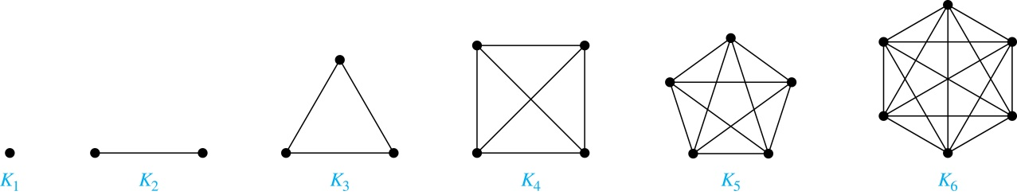
Special Types of Simple Graphs: Complete Graphs
A complete graph on n vertices, denoted by K_{n}, is the simple graph that contains exactly one edge between each pair of distinct vertices.
FREE: For Complete Playlist: https://www.youtube.com/c/FahadHussaintutorial/playlists
For Code, Slide and Books: https://fahadhussaincs.blogspot.com/

Slide 28
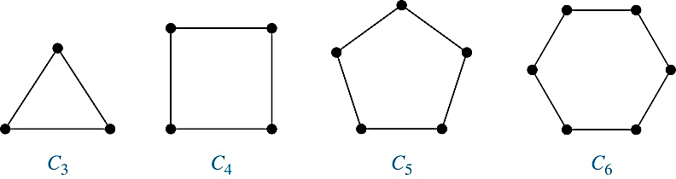
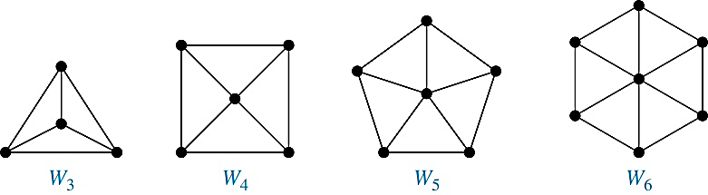
Special Types of Simple Graphs: Cycles and Wheels
A cycle C_{n} for n ≥ 3 consists of n vertices v₁, v₂ ,⋯ , v_{n}, and edges {v₁, v₂}, {v₂, v₃} ,⋯ , {v_{n-1}, v_{n}}, {v_{n}, v₁}.
A wheel W_{n} is obtained by adding an additional vertex to a cycle C_{n} for n ≥ 3 and connecting this new vertex to each of the n vertices in C_{n} by new edges.

Slide 29
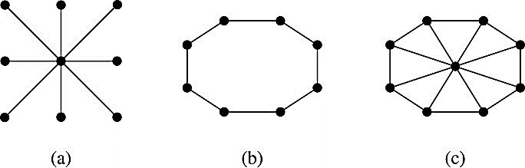
Special Types of Graphs and Computer Network Architecture
Various special graphs play an important role in the design of computer networks.
Some local area networks use a star topology, which is a complete bipartite graph K_{1,n} ,as shown in (a). All devices are connected to a central control device.
Other local networks are based on a ring topology, where each device is connected to exactly two others using C_{n} ,as illustrated in (b). Messages may be sent around the ring.
Others, as illustrated in (c), use a W_{n} – based topology, combining the features of a star topology and a ring topology.
FREE: For Complete Playlist: https://www.youtube.com/c/FahadHussaintutorial/playlists
For Code, Slide and Books: https://fahadhussaincs.blogspot.com/

Slide 30
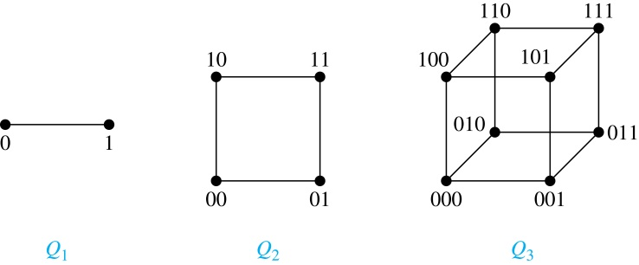
Special Types of Simple Graphs: n-Cubes
An n-dimensional hypercube, or n-cube, Q_{n}, is a graph with 2^{n} vertices representing all bit strings of length n, where there is an edge between two vertices that differ in exactly one bit position.
FREE: For Complete Playlist: https://www.youtube.com/c/FahadHussaintutorial/playlists
For Code, Slide and Books: https://fahadhussaincs.blogspot.com/

Slide 31
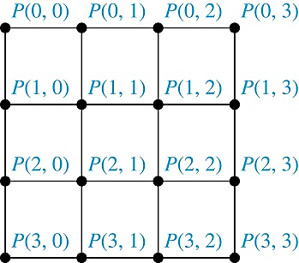
Special Types of Graphs and Computer Network Architecture
Various special graphs also play a role in parallel processing where processors need to be interconnected as one processor may need the output generated by another.
The n-dimensional hypercube, or n-cube, Qn, is a common way to connect processors in parallel, e.g., Intel Hypercube.
Another common method is the mesh network, illustrated here for 16 processors.
FREE: For Complete Playlist: https://www.youtube.com/c/FahadHussaintutorial/playlists
For Code, Slide and Books: https://fahadhussaincs.blogspot.com/

Slide 32
Thanks
FREE: For Complete Playlist: https://www.youtube.com/c/FahadHussaintutorial/playlists
For Code, Slide and Books: https://fahadhussaincs.blogspot.com/

Slide 33
Bipartite Graphs
Definition: A simple graph G is bipartite if V can be partitioned into two disjoint subsets V1 and V2 such that every edge connects a vertex in V1 and a vertex in V2. In other words, there are no edges which connect two vertices in V1 or in V2.
It is not hard to show that an equivalent definition of a bipartite graph is a graph where it is possible to color the vertices red or blue so that no two adjacent vertices are the same color.
What is disjoint Set?
FREE: For Complete Playlist: https://www.youtube.com/c/FahadHussaintutorial/playlists
For Code, Slide and Books: https://fahadhussaincs.blogspot.com/

Slide 34
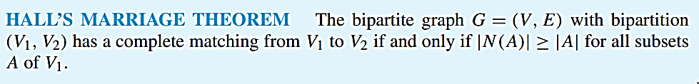
Degree of Vertices
FREE: For Complete Playlist: https://www.youtube.com/c/FahadHussaintutorial/playlists
For Code, Slide and Books: https://fahadhussaincs.blogspot.com/

Slide 35
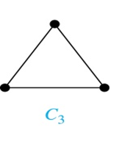
Bipartite Graphs (continued)
Example: Show that C₃ is not bipartite.
Solution: If we divide the vertex set of C₃ into two nonempty sets, one of the two must contain two vertices. But in C₃ every vertex is connected to every other vertex. Therefore, the two vertices in the same partition are connected. Hence, C₃ is not bipartite.
FREE: For Complete Playlist: https://www.youtube.com/c/FahadHussaintutorial/playlists
For Code, Slide and Books: https://fahadhussaincs.blogspot.com/

Slide 36
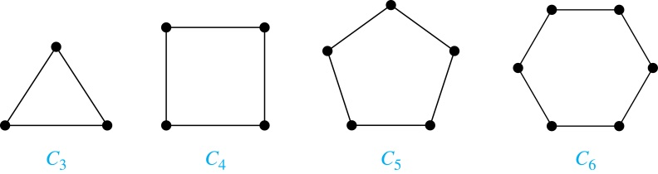
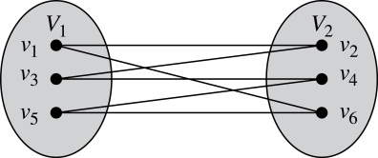
Bipartite Graphs (continued)
Example: Show that C₆ is bipartite.
Solution: We can partition the vertex set into
V₁ = {v₁, v₃, v₅} and V₂ = {v₂, v₄, v₆} so that every edge of C₆ connects a vertex in V₁ and V₂ .
FREE: For Complete Playlist: https://www.youtube.com/c/FahadHussaintutorial/playlists
For Code, Slide and Books: https://fahadhussaincs.blogspot.com/

Slide 37
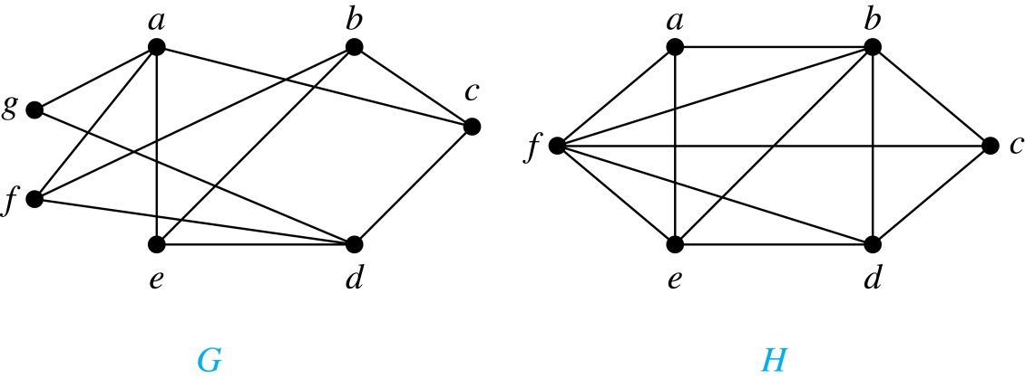
Bipartite Graphs
G is bipartite
H is not bipartite since if we color a red, then the adjacent vertices f and b must both be blue.
FREE: For Complete Playlist: https://www.youtube.com/c/FahadHussaintutorial/playlists
For Code, Slide and Books: https://fahadhussaincs.blogspot.com/

Slide 38
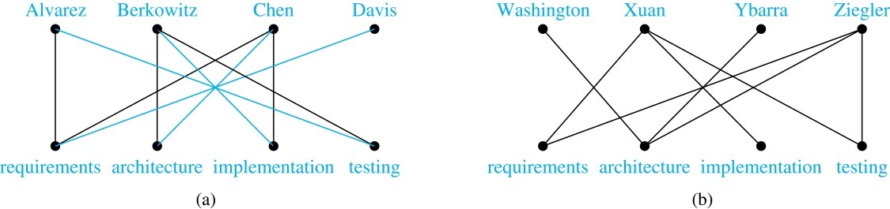
Bipartite Graphs and Matchings
Bipartite graphs are used to model applications that involve matching the elements of one set to elements in another, for example:
Job assignments - vertices represent the jobs and the employees, edges link employees with those jobs they have been trained to do. A common goal is to match jobs to employees so that the most jobs are done.

Slide 39
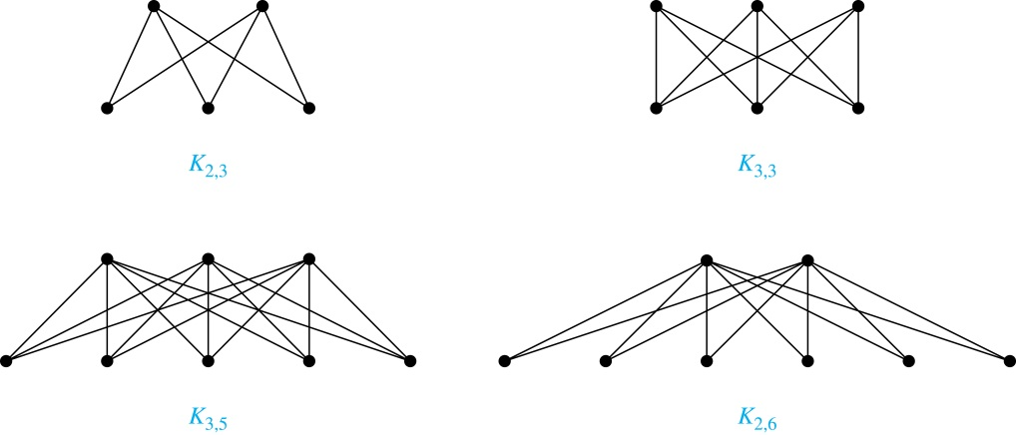
Complete Bipartite Graphs
Definition: A complete bipartite graph K_{m,n} is a graph that has its vertex set partitioned into two subsets V₁ of size m and V₂ of size n such that there is an edge from every vertex in V₁ to every vertex in V₂.
Example: We display four complete bipartite graphs here.

Slide 40
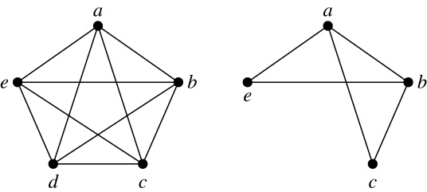
New Graphs from Old
Definition: A subgraph of a graph G = (V,E) is a graph (W,F), where W ⊂ V and F ⊂ E. A subgraph H of G is a proper subgraph of G if H ≠ G.
Example: Here we show K₅ and one of its subgraphs.
Definition: Let G = (V, E) be a simple graph. The subgraph induced by a subset W of the vertex set V is the graph (W,F), where the edge set F contains an edge in E if and only if both endpoints are in W.
Example: Here we show K₅ and the subgraph induced by W = {a,b,c,e}.

Slide 41
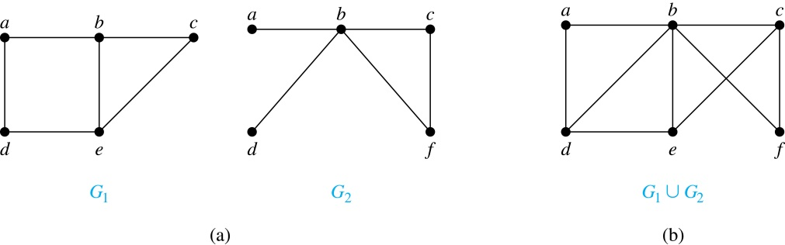
New Graphs from Old (continued)
Definition: The union of two simple graphs G₁ = (V₁, E₁) and G₂ = (V₂, E₂) is the simple graph with vertex set V₁ ⋃ V₂ and edge set E₁ ⋃ E₂. The union of G₁ and G₂ is denoted by G₁ ⋃ G₂.
Example:
FREE: For Complete Playlist: https://www.youtube.com/c/FahadHussaintutorial/playlists
For Code, Slide and Books: https://fahadhussaincs.blogspot.com/

Slide 42
Section Summary
Representations of Graphs
Section 10.3
Adjacency Lists
Adjacency Matrices
Incidence Matrices
FREE: For Complete Playlist: https://www.youtube.com/c/FahadHussaintutorial/playlists
For Code, Slide and Books: https://fahadhussaincs.blogspot.com/

Slide 43
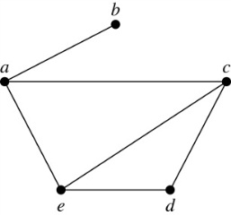
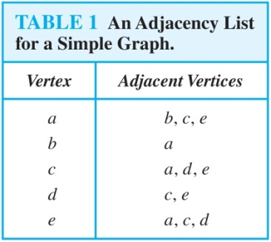
Representing Graphs: Adjacency Lists
Definition: An adjacency list can be used to represent a graph with no multiple edges by specifying the vertices that are adjacent to each vertex of the graph.
Example:
FREE: For Complete Playlist: https://www.youtube.com/c/FahadHussaintutorial/playlists
For Code, Slide and Books: https://fahadhussaincs.blogspot.com/

Slide 44
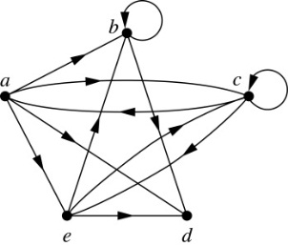
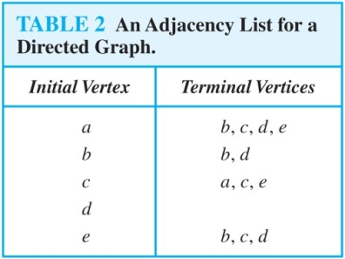
Representing Graphs: Adjacency Lists
Example:
FREE: For Complete Playlist: https://www.youtube.com/c/FahadHussaintutorial/playlists
For Code, Slide and Books: https://fahadhussaincs.blogspot.com/

Slide 45
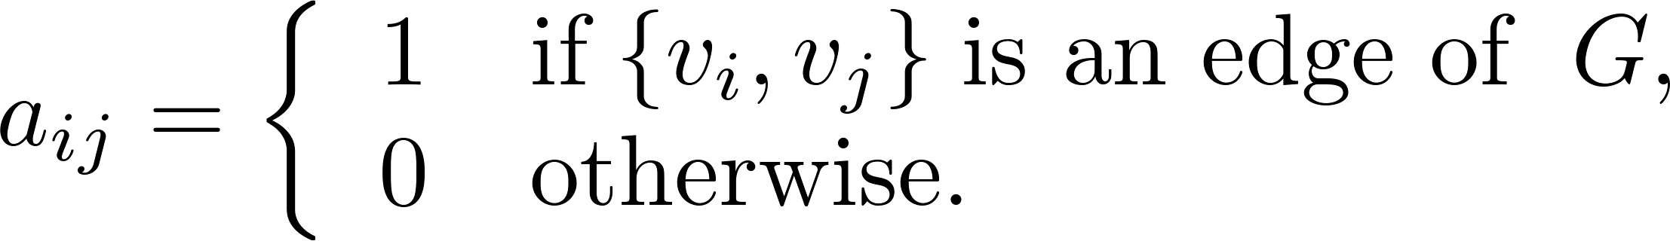
Representation of Graphs: Adjacency Matrices
Definition: Suppose that G = (V, E) is a simple graph where |V| = n. Arbitrarily list the vertices of G as v₁, v₂, … , v_{n}. The adjacency matrix A_{G} of G, with respect to the listing of vertices, is the n × n zero-one matrix with 1 as its (i, j)th entry when v_{i} and v_{j} are adjacent, and 0 as its (i, j)th entry when they are not adjacent.
In other words, if the graphs adjacency matrix is A_{G} = [a_{ij}], then
FREE: For Complete Playlist: https://www.youtube.com/c/FahadHussaintutorial/playlists
For Code, Slide and Books: https://fahadhussaincs.blogspot.com/

Slide 46
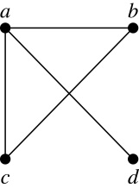
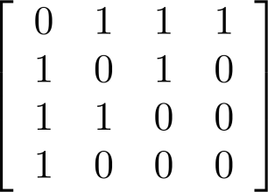
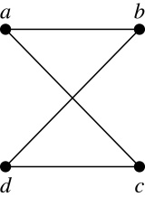
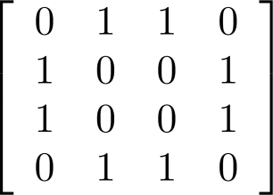
Adjacency Matrices (continued)
Example:
When a graph is sparse, that is, it has few edges relatively to the total number of possible edges, it is much more efficient to represent the graph using an adjacency list than an adjacency matrix. But for a dense graph, which includes a high percentage of possible edges, an adjacency matrix is preferable.
The ordering
of vertices is a, b, c, d.
The ordering of vertices is a, b, c, d.
Note: The adjacency matrix of a simple graph is symmetric, i.e., a_{ij} = a_{ji}
Also, since there are no loops, each diagonal entry a_{ij} for i = 1, 2, 3, …, n, is 0.

Slide 47
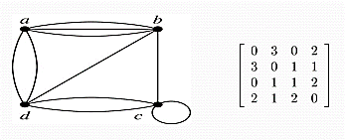
Adjacency Matrices (continued)
Adjacency matrices can also be used to represent graphs with loops and multiple edges.
A loop at the vertex vi is represented by a 1 at the (i, j)th position of the matrix.
When multiple edges connect the same pair of vertices vi and vj, (or if multiple loops are present at the same vertex), the (i, j)th entry equals the number of edges connecting the pair of vertices.
Example: We give the adjacency matrix of the pseudograph shown here using the ordering of vertices a, b, c, d.
FREE: For Complete Playlist: https://www.youtube.com/c/FahadHussaintutorial/playlists
For Code, Slide and Books: https://fahadhussaincs.blogspot.com/

Slide 48
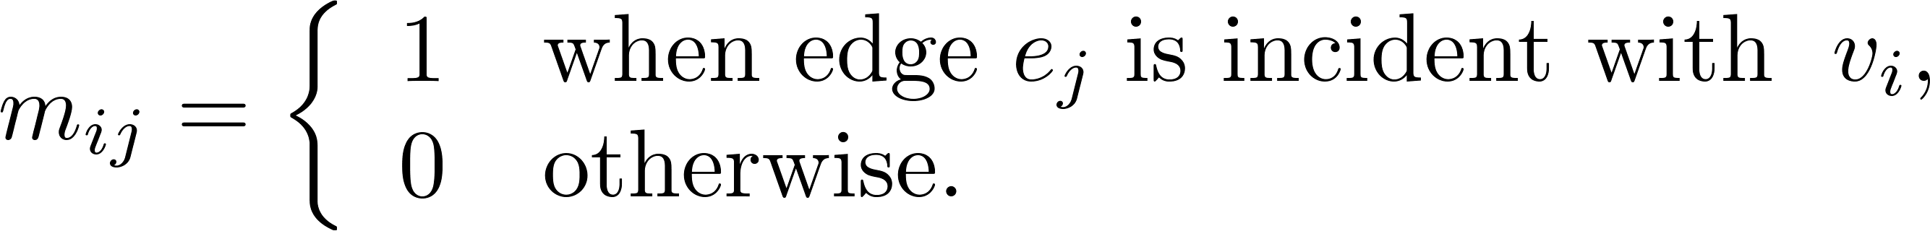
Representation of Graphs: Incidence Matrices
Definition: Let G = (V, E) be an undirected graph with vertices where v₁, v₂, … v_{n} and edges e₁, e₂, … e_{m}. The incidence matrix with respect to the ordering of V and E is the n × m matrix M = [m_{ij}], where
FREE: For Complete Playlist: https://www.youtube.com/c/FahadHussaintutorial/playlists
For Code, Slide and Books: https://fahadhussaincs.blogspot.com/

Slide 49
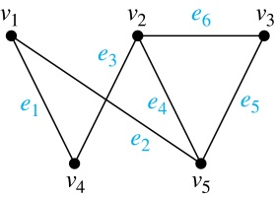
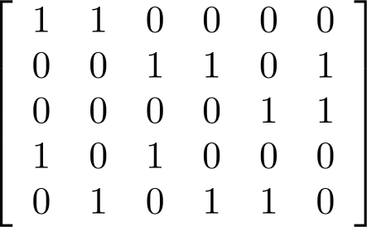
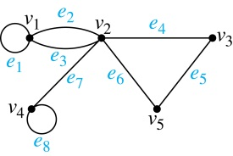
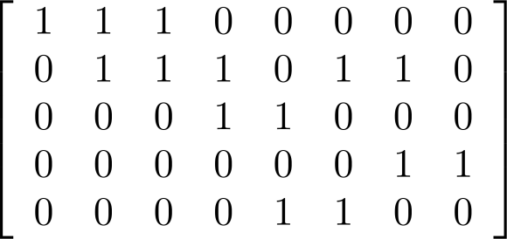
Incidence Matrices (continued)
Example: Simple Graph and Incidence Matrix
The rows going from top to bottom represent v₁ through v₅ and the columns going from left to right represent e₁ through e₆.
Example: Pseudograph and Incidence Matrix
The rows going from top to bottom represent v₁ through v₅ and the columns going from left to right represent e₁ through e₈.

Slide 50
Connectivity
Section 10.4

Slide 51
Paths
Informal Definition: A path is a sequence of edges that begins at a vertex of a graph and travels from vertex to vertex along edges of the graph. As the path travels along its edges, it visits the vertices along this path, that is, the endpoints of these.
Applications: Numerous problems can be modeled with paths formed by traveling along edges of graphs such as:
determining whether a message can be sent between two computers.
efficiently planning routes for mail delivery.

Slide 52
Paths
Definition: Let n be a nonnegative integer and G an undirected graph. A path of length n from u to v in G is a sequence of n edges e₁, … , e_{n} of G for which there exists a sequence x₀ = u, x₁, …, x_{n-1}, x_{n} = v of vertices such that e_{i} has, for i = 1, …, n, the endpoints x_{i-1} and x_{i}.
When the graph is simple, we denote this path by its vertex sequence x₀, x₁, … , x_{n}(since listing the vertices uniquely determines the path).
The path is a circuit if it begins and ends at the same vertex (u = v) and has length greater than zero.
The path or circuit is said to pass through the vertices x₁, x₂, … , x_{n-1} and traverse the edges e₁, … , e_{n}.
A path or circuit is simple if it does not contain the same edge more than once.
FREE: For Complete Playlist: https://www.youtube.com/c/FahadHussaintutorial/playlists
For Code, Slide and Books: https://fahadhussaincs.blogspot.com/

Slide 53
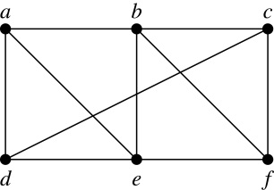
Paths (continued)
Example: In the simple graph here:
a, d, c, f, e is a simple path of length 4.
d, e, c, a is not a path because e is not connected to c.
b, c, f, e, b is a circuit of length 4.
a, b, e, d, a, b is a path of length 5, but it is not a simple path.
FREE: For Complete Playlist: https://www.youtube.com/c/FahadHussaintutorial/playlists
For Code, Slide and Books: https://fahadhussaincs.blogspot.com/

Slide 54
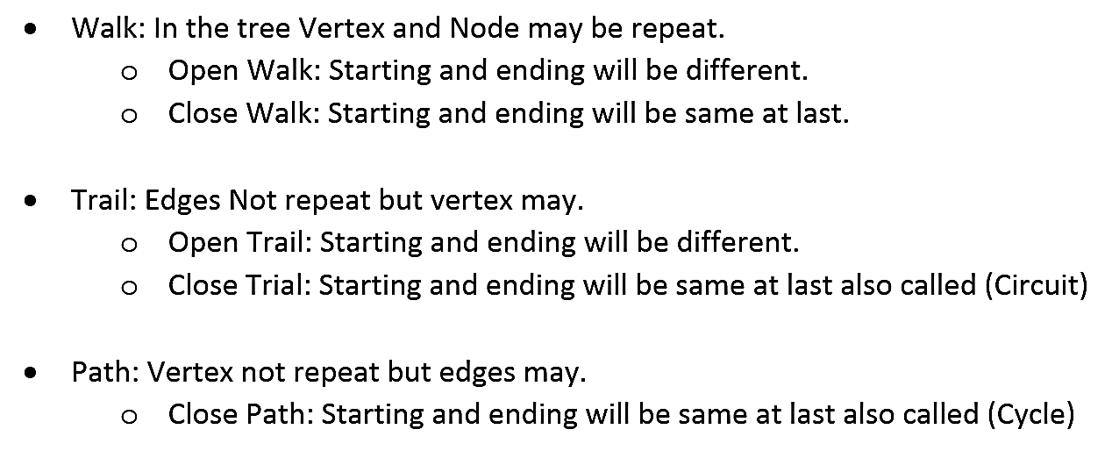
Summary of WALK TRAIL and PATH
FREE: For Complete Playlist: https://www.youtube.com/c/FahadHussaintutorial/playlists
For Code, Slide and Books: https://fahadhussaincs.blogspot.com/

Slide 55
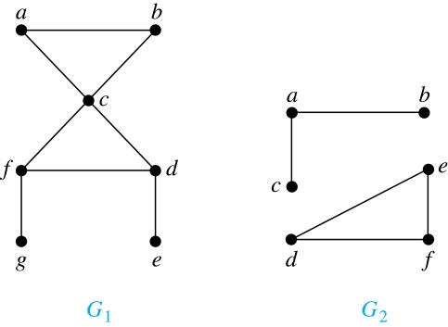
Connectedness in Undirected Graphs
Definition: An undirected graph is called connected if there is a path between every pair of vertices. An undirected graph that is not connected is called disconnected. We say that we disconnect a graph when we remove vertices or edges, or both, to produce a disconnected subgraph.
Example: G₁ is connected because there is a path between any pair of its vertices, as can be easily seen. However G₂ is not connected because there is no path between vertices a and f, for example.
FREE: For Complete Playlist: https://www.youtube.com/c/FahadHussaintutorial/playlists
For Code, Slide and Books: https://fahadhussaincs.blogspot.com/

Slide 56
Connected and Strongly Connected Components in a Graph
FREE: For Complete Playlist: https://www.youtube.com/c/FahadHussaintutorial/playlists
For Code, Slide and Books: https://fahadhussaincs.blogspot.com/

Slide 57
Euler and Hamiltonian Graphs
Section 10.5

Slide 58
Section Summary
Euler and Hamiltonian Graphs
Section 10.5
Euler Paths and Circuits
Hamilton Paths and Circuits
Applications of Hamilton Circuits

Slide 59


Euler Graph, Paths and Circuits
The town of Kӧnigsberg, Prussia
(now Kalingrad, Russia) was divided into four sections by the branches of the Pregel river. In the 18th century seven bridges connected these regions.
People wondered whether it was possible to follow a path that crosses each bridge exactly once and returns to the starting point.
The Swiss mathematician Leonard Euler proved that no such path exists. This result is often considered to be the first theorem ever proved in graph theory.

Slide 60

Euler Paths and Circuits
Definition: An Euler circuit in a graph G is a simple circuit containing every edge of G. An Euler path in G is a simple path containing every edge of G.
Example: Which of the undirected graphs G₁, G₂, and G₃ has a Euler circuit? Of those that do not, which has an Euler path?
Solution: The graph G₁ has an Euler circuit (e.g., a, e, c, d, e, b, a). But, as can easily be verified by inspection, neither G₂ nor G₃ has an Euler circuit. Note that G₃ has an Euler path (e.g., a, c, d, e, b, d, a, b), but there is no Euler path in G₂, which can be verified by inspection.
FREE: For Complete Playlist: https://www.youtube.com/c/FahadHussaintutorial/playlists
For Code, Slide and Books: https://fahadhussaincs.blogspot.com/

Slide 61

Euler Circuits and Paths
Example:
G₁ contains exactly two vertices of odd degree (b and d). Hence it has an Euler path, e.g., d, a, b, c, d, b.
G₂ has exactly two vertices of odd degree (b and d). Hence it has an Euler path, e.g., b, a, g, f, e, d, c, g, b, c, f, d.
G₃ has six vertices of odd degree. Hence, it does not have an Euler path.

Slide 62
Necessary Conditions for Euler Circuits and Paths
An Euler circuit begins with a vertex a and continues with an edge incident with a, say {a, b}. The edge {a, b} contributes one to deg(a).
Each time the circuit passes through a vertex it contributes two to the vertex’s degree.
Finally, the circuit terminates where it started, contributing one to deg(a). Therefore deg(a) must be even.
We conclude that the degree of every other vertex must also be even.
By the same reasoning, we see that the initial vertex and the final vertex of an Euler path have odd degree, while every other vertex has even degree. So, a graph with an Euler path has exactly two vertices of odd degree.
In the next slide we will show that these necessary conditions are also sufficient conditions.
FREE: For Complete Playlist: https://www.youtube.com/c/FahadHussaintutorial/playlists
For Code, Slide and Books: https://fahadhussaincs.blogspot.com/

Slide 63

Algorithm for Constructing an Euler Circuits
In our proof we developed this algorithms for constructing a Euler circuit in a graph with no vertices of odd degree.

Slide 64
Applications of Euler Paths and Circuits
Euler paths and circuits can be used to solve many practical problems such as finding a path or circuit that traverses each
street in a neighborhood,
road in a transportation network,
connection in a utility grid,
link in a communications network.
Other applications are found in the
layout of circuits,
network multicasting,
molecular biology, where Euler paths are used in the sequencing of DNA.
FREE: For Complete Playlist: https://www.youtube.com/c/FahadHussaintutorial/playlists
For Code, Slide and Books: https://fahadhussaincs.blogspot.com/

Slide 65

Necessary and Sufficient Conditions for Euler Circuits and Paths (continued)
Theorem: A connected multigraph with at least two vertices has an Euler circuit if and only if each of its vertices has an even degree and it has an Euler path if and only if it has exactly two vertices of odd degree.
Example: Two of the vertices in the multigraph model of the Kӧnigsberg bridge problem have odd degree. Hence, there is no Euler circuit in this multigraph and it is impossible to start at a given point, cross each bridge exactly once, and return to the starting point.

Slide 66

Understanding Mohammed’s Scimitars.

Slide 67
Fleury’s Algorithm for printing Eulerian Path or Circuit
Eulerian Path is a path in a graph that visits every edge exactly once. Eulerian Circuit is an Eulerian Path that starts and ends on the same vertex.
Following is Fleury’s Algorithm for printing the Eulerian trail or cycle
Make sure the graph has either 0 or 2 odd vertices.
If there are 0 odd vertices, start anywhere. If there are 2 odd vertices, start at one of them.
Follow edges one at a time. If you have a choice between a bridge and a non-bridge, always choose the non-bridge.
Stop when you run out of edges.
The idea is, “don’t burn bridges“ so that we can come back to a vertex and traverse the remaining edges. For example, let us consider the following graph.

Slide 68



Hamilton Paths and Circuits
William Rowan Hamilton
(1805- 1865)
Euler paths and circuits contained every edge only once.
Now we look at paths and circuits that contain every vertex exactly once.
William Hamilton invented the Icosian puzzle in 1857. It consisted of a wooden dodecahedron (with 12 regular pentagons as faces), illustrated in
(a), with a peg at each vertex, labeled with the names of different cities. String was used to used to plot a circuit visiting 20 cities exactly once. The graph form of the puzzle is given in (b).
The solution (a Hamilton circuit) is given here.

Slide 69
Hamilton Paths and Circuits
Definition: A simple path in a graph G that passes through every vertex exactly once is called a Hamilton path, and a simple circuit in a graph G that passes through every vertex exactly once is called a Hamilton circuit.
That is, a simple path x₀, x₁, …, x_{n-1}, x_{n} in the graph G = (V, E) is called a Hamilton path if V = {x₀, x₁, … , x_{n-1,} x_{n} } and x_{i} ≠ x_{j} for 0≤ i < j ≤ n, and the simple circuit x₀, x₁, …, x_{n-1}, x_{n}, x₀ (with n > 0) is a Hamilton circuit if x₀, x₁, … , x_{n-1}, x_{n} is a Hamilton path.
FREE: For Complete Playlist: https://www.youtube.com/c/FahadHussaintutorial/playlists
For Code, Slide and Books: https://fahadhussaincs.blogspot.com/

Slide 70

Hamilton Paths and Circuits
FREE: For Complete Playlist: https://www.youtube.com/c/FahadHussaintutorial/playlists
For Code, Slide and Books: https://fahadhussaincs.blogspot.com/

Slide 71
Hamilton Paths and Circuits
Example: Which of these simple graphs has a Hamilton circuit or, if not, a Hamilton path?
Solution:
G₁ does not have a Hamilton circuit (Why?), but does have a Hamilton path : a, b ,e , c, d.
G₂ has a Hamilton circuit: a, b, c, d, e, a.
G₃ has a Hamilton circuit: a,b,e,d,c,a
FREE: For Complete Playlist: https://www.youtube.com/c/FahadHussaintutorial/playlists
For Code, Slide and Books: https://fahadhussaincs.blogspot.com/

Slide 72


Necessary Conditions for Hamilton Circuits
Gabriel Andrew Dirac
(1925-1984)
Unlike for an Euler circuit, no simple necessary and sufficient conditions are known for the existence of a Hamiton circuit.
However, there are some useful necessary conditions. We describe two of these now.
Dirac’s Theorem: If G is a simple graph with n ≥ 3 vertices such that the degree of every vertex in G is ≥ n/2, then G has a Hamilton circuit.
Ore’s Theorem: If G is a simple graph with n ≥ 3 vertices such that deg(u) + deg(v) ≥ n for every pair of nonadjacent vertices, then G has a Hamilton circuit.
Øysten Ore
(1899-1968)
FREE: For Complete Playlist: https://www.youtube.com/c/FahadHussaintutorial/playlists
For Code, Slide and Books: https://fahadhussaincs.blogspot.com/

Slide 73
Applications of Hamilton Paths and Circuits
Applications that ask for a path or a circuit that visits each intersection of a city, each place pipelines intersect in a utility grid, or each node in a communications network exactly once, can be solved by finding a Hamilton path in the appropriate graph.
The famous traveling salesperson problem (TSP) asks for the shortest route a traveling salesperson should take to visit a set of cities. This problem reduces to finding a Hamilton circuit such that the total sum of the weights of its edges is as small as possible.
A family of binary codes, known as Gray codes, which minimize the effect of transmission errors, correspond to Hamilton circuits in the n-cube Q_{n.}
FREE: For Complete Playlist: https://www.youtube.com/c/FahadHussaintutorial/playlists
For Code, Slide and Books: https://fahadhussaincs.blogspot.com/

Slide 74
ISOMORPHISM OF GRAPHS
Section 10.3

Slide 75

Isomorphism of Graphs
Definition: The simple graphs G₁ = (V₁, E₁) and G₂ = (V₂, E₂) are isomorphic if there is a one-to-one and onto function f from V₁ to V₂ with the property that a and b are adjacent in G₁ if and only if f(a) and f(b) are adjacent in G₂ , for all a and b in V₁ . Such a function f is called an isomorphism. Two simple graphs that are not isomorphic are called nonisomorphic.
FREE: For Complete Playlist: https://www.youtube.com/c/FahadHussaintutorial/playlists
For Code, Slide and Books: https://fahadhussaincs.blogspot.com/

Slide 76
Isomorphism of Graphs
It is difficult to determine whether two simple graphs are isomorphic using brute force because there are n! possible one-to-one correspondences between the vertex sets of two simple graphs with n vertices.
The best algorithms for determining weather two graphs are isomorphic have exponential worst case complexity in terms of the number of vertices of the graphs.
Sometimes it is not hard to show that two graphs are not isomorphic. We can do so by finding a property, preserved by isomorphism, that only one of the two graphs has. Such a property is called graph invariant.
FREE: For Complete Playlist: https://www.youtube.com/c/FahadHussaintutorial/playlists
For Code, Slide and Books: https://fahadhussaincs.blogspot.com/

Slide 77
Isomorphism of Graphs
Number of Vertices
Number of Edges
Degree of Sequence
Mapping
FREE: For Complete Playlist: https://www.youtube.com/c/FahadHussaintutorial/playlists
For Code, Slide and Books: https://fahadhussaincs.blogspot.com/

Slide 78
Isomorphism of Graphs (cont.)
Example: Show that the graphs G =(V, E) and H = (W, F) are isomorphic.
Solution: The function f with
f(u₁) = v₁,f(u₂) = v₄, f(u₃) = v₃, and f(u₄) = v₂ is a one-to-one
correspondence between V and W.
Note that adjacent vertices in G are
u₁ and u₂, u₁ and u₃, u₂ and u₄,
and u₃ and u₄. Each of the pairs
f(u₁) = v₁ and f(u₂) = v₄, f(u₁) = v₁
and f(u₃) = v₃ , f(u₂) = v₄ and
f(u₄) = v₂ , and f(u₃) = v₃ and
f(u₄) = v₂ consists of two adjacent vertices in H.
FREE: For Complete Playlist: https://www.youtube.com/c/FahadHussaintutorial/playlists
For Code, Slide and Books: https://fahadhussaincs.blogspot.com/

Slide 79



Isomorphism of Graphs
Example: Show that the graphs G =(V, E) and G’ = (W, F) are isomorphic.
Solution: The function f with
f(v1) = v1,f(v2) = v3, f(v3) = v5, f(v4) = v2 and f(v5) = v4 is a one-to-one correspondence between V and W.
Note that adjacent vertices in G are v1 and v2, v2 and v3, v3 and v4, v4 and v5 and v5 and v1.
Each of the pairs f(v1) = v1 and f(v2) = v3, f(v2) = v3 and f(v3) = v5 , f(v3) = v5 and
f(v4) = v2 , f(v4) = v2 and f(v5) = v4 and f(v5) = v4 and f(v1) = v1 consists of two adjacent vertices in H.
FREE: For Complete Playlist: https://www.youtube.com/c/FahadHussaintutorial/playlists
For Code, Slide and Books: https://fahadhussaincs.blogspot.com/

Slide 80

Isomorphism of Graphs
EXAMPLE: Determine whether the graph G and G’ given below are isomorphic.
SOLUTION:
As both the graphs have the same number of vertices. But the graph G has 7 edges and the graph G’ has only 6 edges. Therefore the two graphs are not isomorphic.
Note: As the edges of both the graphs G and G’ are not same then how the one-one correspondence is possible ,that the reason the graphs G and G’ are not isomorphic.
FREE: For Complete Playlist: https://www.youtube.com/c/FahadHussaintutorial/playlists
For Code, Slide and Books: https://fahadhussaincs.blogspot.com/

Slide 81

Isomorphism of Graphs
EXAMPLE: Determine whether the graph G and G’ given below are isomorphic.
SOLUTION:
Both the graphs have 5 vertices and 7 edges. The vertex q of G’ has degree 5. However G does not have any vertex of degree 5 (so one-one correspondence is not possible). Hence, the two graphs are not isomorphic.
FREE: For Complete Playlist: https://www.youtube.com/c/FahadHussaintutorial/playlists
For Code, Slide and Books: https://fahadhussaincs.blogspot.com/

Slide 82

Isomorphism of Graphs
EXAMPLE: Determine whether the graph G and G’ given below are isomorphic.
SOLUTION:
Clearly the vertices of both the graphs G and G’ have the same degree (i.e “2”) and having the same number of vertices and edges but isomorphism is not possible. As the graph G’ is a connected graph but the graph G is not connected due to have two components (eca and bdf). Therefore the two graphs are non isomorphic.
FREE: For Complete Playlist: https://www.youtube.com/c/FahadHussaintutorial/playlists
For Code, Slide and Books: https://fahadhussaincs.blogspot.com/

Slide 83

Isomorphism of Graphs
EXAMPLE: Determine whether the graph G and G’ given below are isomorphic.
SOLUTION:
Clearly G has six vertices, G’ also has six vertices. And the graph G has two simple circuits of length 3; one is abca and the other is defd. But G’ does not have any simple circuit of length 3(as one simple circuit in G’ is uxwvu of length 4).Therefore the two graphs are non-isomorphic.
Note: A simple circuit is a circuit that does not have any other repeated vertex except the first and last.

Slide 84

Isomorphism of Graphs
EXAMPLE: Determine whether the graph G and G’ given below are isomorphic.
SOLUTION:
Both the graph G and G’ have 8 vertices and 12 edges and both are also called regular graph(as each vertex has degree 3).The graph G has two simple circuits of length 5; abcfea(i.e starts and ends at a) and cdhgfc(i.e starts and ends at c). But G’ does not have any simple circuit of length 5 (it has simple circuit tyxut,vwxuv of length 4 etc). Therefore the two graphs are non-isomorphic.
FREE: For Complete Playlist: https://www.youtube.com/c/FahadHussaintutorial/playlists
For Code, Slide and Books: https://fahadhussaincs.blogspot.com/

Slide 85



Isomorphism of Graphs
EXAMPLE: Determine whether the given graph G and H are isomorphic.
Solution:
Solution: The function f with
f(a) = u, f(b) = v, f(c) = y, f(d) = x, f(e) = w and f(f) = z is a one-to-one correspondence between G and H.
Note that adjacent vertices in G are a and b, b and c, c and d, c and f, d and e, e and f and f and a.
Each of the pairs f(a) = u and f(b) = v, f(b) = v and f(c) = y , f(c) = y and f(d) = x , f(c) = y and f(f) = z , f(d) = x and f(e) = w, f(e) = w and f(f) = z and f(f) = z and f(a) = u consists of two adjacent vertices in H.

Slide 86
Algorithms for Graph Isomorphism
The best algorithms known for determining whether two graphs are isomorphic have exponential worst-case time complexity (in the number of vertices of the graphs).
However, there are algorithms with linear average-case time complexity.
You can use a public domain program called NAUTY to determine in less than a second whether two graphs with as many as 100 vertices are isomoprhic.
FREE: For Complete Playlist: https://www.youtube.com/c/FahadHussaintutorial/playlists
For Code, Slide and Books: https://fahadhussaincs.blogspot.com/

Slide 87
Applications of Graph Isomorphism
The question whether graphs are isomorphic plays an important role in applications of graph theory. For example,
chemists use molecular graphs to model chemical compounds. Vertices represent atoms and edges represent chemical bonds. When a new compound is synthesized, a database of molecular graphs is checked to determine whether the graph representing the new compound is isomorphic to the graph of a compound that this already known.
Electronic circuits are modeled as graphs in which the vertices represent components and the edges represent connections between them. Graph isomorphism is the basis for
the verification that a particular layout of a circuit corresponds to the design’s original schematics.
determining whether a chip from one vendor includes the intellectual property of another vendor.

Slide 88
10.6
Shortest-Path Problems

Slide 89
Weighted Graphs
Graphs that have a number assigned to each edge are called weighted graphs.
BOS
CHI
NY
SF
DEN
ATL
LA
MIA
FREE: For Complete Playlist: https://www.youtube.com/c/FahadHussaintutorial/playlists
For Code, Slide and Books: https://fahadhussaincs.blogspot.com/

Slide 90
Weighted Graphs
MILES
BOS
2534
860
191
1855
722
NY
CHI
SF
DEN
908
957
606
760
349
834
2451
1090
ATL
LA
595
MIA
FREE: For Complete Playlist: https://www.youtube.com/c/FahadHussaintutorial/playlists
For Code, Slide and Books: https://fahadhussaincs.blogspot.com/

Slide 91
Weighted Graphs
FARES
BOS
$129
$79
$39
$99
$59
NY
CHI
SF
DEN
$69
$89
$79
$89
$99
$39
$129
ATL
LA
$69
MIA
FREE: For Complete Playlist: https://www.youtube.com/c/FahadHussaintutorial/playlists
For Code, Slide and Books: https://fahadhussaincs.blogspot.com/

Slide 92
Weighted Graphs
FLIGHT TIMES
BOS
4:05
2:10
0:50
2:55
NY
CHI
1:50
SF
DEN
2:10
2:20
1:55
1:40
1:15
2:00
3:50
2:45
ATL
LA
1:30
MIA
FREE: For Complete Playlist: https://www.youtube.com/c/FahadHussaintutorial/playlists
For Code, Slide and Books: https://fahadhussaincs.blogspot.com/

Slide 93
Weighted Graphs
A weighted graph is a graph in which each edge (u, v) has a weight w(u, v). Each weight is a real number.
Weights can represent distance, cost, time, capacity, etc.
The length of a path in a weighted graph is the sum of the weights on the edges.
Dijkstra vs Bellman Ford vs Floyd Warshall
Dijkstra’s Algorithm finds the shortest path between two vertices.
FREE: For Complete Playlist: https://www.youtube.com/c/FahadHussaintutorial/playlists
For Code, Slide and Books: https://fahadhussaincs.blogspot.com/

Slide 94
Dijkstra’s Algorithm
Dijkstra’s algorithm is used in problems relating to finding the shortest path.
Each node is given a temporary label denoting the length of the shortest path from the start node so far.
This label is replaced if another shorter route is found.
Once it is certain that no other shorter paths can be found, the temporary label becomes a permanent label.
Eventually all the nodes have permanent labels.
At this point the shortest path is found by retracing the path backwards.
FREE: For Complete Playlist: https://www.youtube.com/c/FahadHussaintutorial/playlists
For Code, Slide and Books: https://fahadhussaincs.blogspot.com/

Slide 95
Dijkstra’s algorithm: example
D(v)
D(w)
D(x)
D(y)
D(z)
Step
N'
0
u
7,u
3,u
5,u
∞
∞
1
uw
6,w
5,u
11,w
∞
2
uwx
6,w
11,w
14,x
3
uwxv
10,v
14,x
4
uwxvy
12,y
5
uwxvyz
x
9
notes:
construct shortest path tree by tracing predecessor nodes
ties can exist (can be broken arbitrarily)
5
7
4
8
u
3
w
y
z
2
3
7
4
v

Slide 96
Dijkstra’s algorithm: another example
Step
0
1
2
3
4
5
N'
u
ux
uxy
uxyv
uxyvw
uxyvwz
D(v)
2,u
2,u
2,u
D(w)
5,u
4,x
3,y
3,y
D(x)
1,u
D(y)
∞
2,x
D(z)
∞
∞
4,y
4,y
4,y
5
v
3
w
2
5
u
2
1
z
3
1
2
x
y
1
FREE: For Complete Playlist: https://www.youtube.com/c/FahadHussaintutorial/playlists
For Code, Slide and Books: https://fahadhussaincs.blogspot.com/

Slide 97

FREE: For Complete Playlist: https://www.youtube.com/c/FahadHussaintutorial/playlists
For Code, Slide and Books: https://fahadhussaincs.blogspot.com/

Slide 98
Problem: shortest path from a to z
b
d
5
f
5
4
7
3
4
1
2
a
z
3
4
c
5
e
5
g
FREE: For Complete Playlist: https://www.youtube.com/c/FahadHussaintutorial/playlists
For Code, Slide and Books: https://fahadhussaincs.blogspot.com/

Slide 99
The Traveling Salesman Problem
The traveling salesman problem is one of the classical problems in computer science.
A traveling salesman wants to visit a number of cities and then return to his starting point. Of course he wants to save time and energy, so he wants to determine the shortest cycle for his trip.
We can represent the cities and the distances between them by a weighted, complete, undirected graph.
The problem then is to find the shortest cycle (of minimum total weight that visits each vertex exactly one).
Finding the shortest cycle is different than Dijkstra’s shortest path. It is much harder too, no polynomial time algorithm exists!

Slide 100
The Traveling Salesman Problem
Importance:
Variety of scheduling application can be solved as a traveling salesmen problem.
Examples:
Ordering drill position on a drill press.
School bus routing.
The problem has theoretical importance because it represents a class of difficult problems known as NP-hard problems.
FREE: For Complete Playlist: https://www.youtube.com/c/FahadHussaintutorial/playlists
For Code, Slide and Books: https://fahadhussaincs.blogspot.com/

Slide 101

Travelling Salesman problem
FREE: For Complete Playlist: https://www.youtube.com/c/FahadHussaintutorial/playlists
For Code, Slide and Books: https://fahadhussaincs.blogspot.com/

Slide 102

Travelling Salesman problem
FREE: For Complete Playlist: https://www.youtube.com/c/FahadHussaintutorial/playlists
For Code, Slide and Books: https://fahadhussaincs.blogspot.com/

Slide 103
10.7 Planar Graphs

Slide 104

The House-and-Utilities Problem

Slide 105
Planar Graphs
A graph is called planar if it can be drawn in the plane without any edges crossing.
A crossing of edges is the intersection of the lines or arcs representing them at a point other than their common endpoint.
Such a drawing is called a planar representation of the graph.
FREE: For Complete Playlist: https://www.youtube.com/c/FahadHussaintutorial/playlists
For Code, Slide and Books: https://fahadhussaincs.blogspot.com/

Slide 106
Example
A graph may be planar even if it is usually drawn with crossings, since it may be possible to draw it in another way without crossings.
FREE: For Complete Playlist: https://www.youtube.com/c/FahadHussaintutorial/playlists
For Code, Slide and Books: https://fahadhussaincs.blogspot.com/

Slide 107

Example
A graph may be planar even if it represents a 3-dimensional object.
FREE: For Complete Playlist: https://www.youtube.com/c/FahadHussaintutorial/playlists
For Code, Slide and Books: https://fahadhussaincs.blogspot.com/

Slide 108
Planar Graphs
We can prove that a particular graph is planar by showing how it can be drawn without any crossings.
However, not all graphs are planar.
It may be difficult to show that a graph is nonplanar. We would have to show that there is no way to draw the graph without any edges crossing.
FREE: For Complete Playlist: https://www.youtube.com/c/FahadHussaintutorial/playlists
For Code, Slide and Books: https://fahadhussaincs.blogspot.com/

Slide 109
Regions
Euler devised a formula for expressing the relationship between the number of vertices, edges, and regions of a planar graph.
These may help us determine if a graph can be planar or not.

Slide 110
Euler’s Formula
Let G be a connected planar simple graph with e edges and v vertices. Let r be the number of regions in a planar representation of G. Then r = e - v + 2.
R₄ R₃ R₂
R₁
# of edges, e = 6
# of vertices, v = 4
# of regions, r = e - v + 2 = 4

Slide 111
Euler’s Formula (Cont.)
Corollary 1: If G is a connected planar simple graph with e edges and v vertices where v ≥ 3, then e ≤ 3v - 6.
Is K₅ planar?
K₅

Slide 112
Euler’s Formula (Cont.)
K₅ has 5 vertices and 10 edges.
We see that v ≥ 3.
So, if K₅ is planar, it must be true that e ≤ 3v – 6.
3v – 6 = 3*5 – 6 = 15 – 6 = 9.
So e must be ≤ 9.
But e = 10.
So, K₅ is nonplanar.
K₅

Slide 113
Euler’s Formula (Cont.)
Corollary 2: If G is a connected planar simple graph, then G must have a vertex of degree not exceeding 5.
If G has one or two vertices, it is true;
thus, we assume that G has at least three vertices.
If the degree of each vertex were at least 6, then by Handshaking Theorem,
2e ≥ 6v, i.e., e ≥ 3v,
but this contradicts the inequality from
Corollary 1: 1 e ≤ 3v – 6.

Slide 114
Euler’s Formula (Cont.)
Corollary 3: If a connected planar simple graph has e edges and v vertices with v ≥ 3 and no circuits of length 3, then e ≤ 2v - 4.
Is K_{3,3} planar?

Slide 115
Euler’s Formula (Cont.)
K_{3,3} has 6 vertices and 9 edges.
Obviously, v ≥ 3 and there are no circuits of length 3.
If K_{3,3} were planar, then e ≤ 2v – 4 would have to be true.
2v – 4 = 2*6 – 4 = 8
So e must be ≤ 8.
But e = 9.
So K_{3,3} is nonplanar.
K_{3,3}

Slide 116
Kuratowski’s Theorem
We have seen that K3,3 and K5 are not planar. Clearly, a graph is not planar if it contains either of these two graphs as a subgraph. Surprisingly, all nonplanar graphs must contain a subgraph that can be obtained from K3,3 or K5 using certain permitted operations. If a graph is planar, so will be any graph obtained by removing an edge {u, v} and adding a new vertex w together with edges {u,w} and {w, v}. Such an operation is called an elementary subdivision. The graphs G1 = (V1, E1) and G2 = (V2, E2) are called homeomorphic if they can be obtained from the same graph by a sequence of elementary subdivisions

Slide 117




10.8 Graph Coloring

Slide 118


10.8 Graph Coloring

Slide 119
10.8 Graph Coloring
A coloring of a simple graph is the assignment of a color to each vertex of the graph so that no two adjacent vertices are assigned the same color.
The chromatic number of a graph is the least number of colors needed for a coloring of this graph. The chromatic number of a graph G is denoted by χ (G).
(Here χ is the Greek letter chi.)
THEOREM 1
THE FOUR COLOR THEOREM The chromatic number of a planar graph is no greater than four.

Slide 120


10.8 Graph Coloring

Slide 121

10.8 Graph Coloring

Slide 122

10.8 Graph Coloring

Slide 123
Applications of Graph Colorings
Scheduling Final Exams How can the final exams at a university be scheduled so that no student has two exams at the same time?
Solution: This scheduling problem can be solved using a graph model, with vertices representing courses and with an edge between two vertices if there is a common student in the courses they represent. Each time slot for a final exam is represented by a different color. A scheduling of the exams corresponds to a coloring of the associated graph. For instance, suppose there are seven finals to be scheduled. Suppose the courses are numbered 1 through 7. Suppose that the following pairs of courses have common students: 1 and 2, 1 and 3, 1 and 4, 1 and 7, 2 and 3, 2 and 4, 2 and 5, 2 and 7, 3 and 4, 3 and 6, 3 and 7, 4 and 5, 4 and 6, 5 and 6, 5 and 7, and 6 and 7. In Figure 8 the graph associated with this set of classes is shown. A scheduling consists of a coloring of this graph. Because the chromatic number of this graph is 4 (the reader should verify this), four time slots are needed. A coloring of the graph using four colors and the associated schedule are shown in Figure 9.

Slide 124

Applications of Graph Colorings

Slide 125

Applications of Graph Colorings

